Slide 1
Creating RTM
Creating Test Scenario
Creating Test Cases
Updating RTM

Slide 2
Overview of Test Design

Slide 3
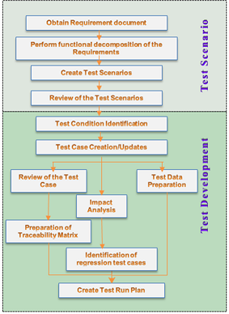
Overview Of Test Design
Test Design is the process of identifying and specifying the details of the test approach for a software feature and identifying the associated Tests
Test Design process involves the following activities:
Obtain the Test Basis (such as requirements, architecture, design, interfaces) for Test Design
Perform functional decomposition of the Requirements
Develop Test Scenarios
Review Test Scenarios
Develop Test Cases for the derived Test Scenarios
Review Test Cases
Prepare Traceability Matrix
Prepare Test Data to support the Test conditions and Test cases
Create Test Run plan
Notes:
Notes:
Test Design is the process of identifying and specifying the details of the test approach for a software feature and identifying the associated Tests. In short, Test Design is the detail of the Tests that are to be performed and the expected outcome.

Slide 4
Test Basis & Functional Decomposition
Test Basis:-
Test Basis is the information needed in order to start the test analysis and create Test Scenarios and Test Cases
Following are the possible Test Basis documents:
Requirements
Functional design
Technical design
User manual
Use cases
Functional decomposition of the requirements:
In the functional decomposition the requirements are decomposed into one or more statements indicating the conditions that have to be set up and tested
Performing the functional decomposition of the requirements into simple statements will be helpful for deriving Test Scenarios.
Notes:
Notes:
Test Basis:
Test Basis is the information needed in order to start the test analysis and create Test Scenarios and Test Cases. There may be a well written and detailed specification document to start with. Ideally, one may get a document describing all use cases including their preconditions, basic flow, and exceptions.
But these documents are not always available. There might as well be lots of different documents, all contradicting each other. In some cases there's even no specification document at all. Only an old version of the application may be available that has to be explored to learn the functionality. Following are the possible Test Basis documents:
Requirements
Functional design
Technical design
User manual
Use cases
Functional decomposition of the requirements:
After obtaining the Test Basis, the very first activity is to perform the functional decomposition for all the testable requirements identified from the Test Basis documents. In the functional decomposition the requirements are decomposed into one or more statements indicating the conditions that have to be set up and tested. The conditions to account are set up for the interaction between requirements.
Performing the functional decomposition of the requirements into simple statements will be helpful for deriving Test Scenarios.

Slide 5
Test Scenario
Test Scenarios represent a powerful tool for test design and are a single event or a sequence of events that happen during the actual usage of the application
The Test Scenario is based on a hypothetical story used to help a person think through a complex problem or system
In an ideal scenario test, the hypothetical story has the following characteristics:
Motivating - A stakeholder would push to fix a program that failed this test
Credible - It not only could happen in the real world; stakeholders would believe that something like it probably will happen
Involves a complex use of the program or environment or set of data
The test results are easy to evaluate
Notes:
Notes:
Test Scenarios represent a powerful tool for test design and are a single event or a sequence of events that happen during the actual usage of the application.
The Test Scenario is based on a hypothetical story used to help a person think through a complex problem or system. They can be as simple as a diagram for a testing environment or they could be a description written in prose. They are usually different from test cases in that test cases are single steps and scenarios cover a number of steps. Test suites and scenarios can be used in concert for complete system tests.
In an ideal scenario test, the hypothetical story has the following characteristics:
Motivating - A stakeholder would push to fix a program that failed this test
Credible - It not only could happen in the real world; stakeholders would believe that something like it probably will happen
Involves a complex use of the program or environment or set of data
The test results are easy to evaluate

Slide 6
Test Scenario
Test Scenarios simplifies a complex problem or system
It covers a specific functional area, business process, use case, and so on
Testable Business Scenarios can be translated to test cases during the Test Development phase.

Slide 7
Benefits Of Test Scenario
Bridges Requirement Analysis and Test Development
Early in testing, identification of scenarios aids to learn the product/ application under test
Serve as tool to ensure that the Requirements are understood completely and clearly
Test Scenarios help in ensuring that all testable requirements are covered.
Test Scenarios are powerful because they tend to use the applications in the same sequence as it would be used in the real world.
Test Scenarios help the SMEs to perform the Test Case review easily
Notes:
Notes:
Benefits of Test Scenario
During the Test Requirement Analysis, the Testable Requirements are identified and the same are translated to Test Scenarios during the Test Development Phase. Test Scenarios are an intermediate phase, where the Test Requirements are analyzed and high level Test Scenarios are identified. Some of the benefits of Test Scenarios are as follows:
Bridges Requirement Analysis and Test Development
Early in testing, identification of scenarios aids to learn the product/ application under test
During the Requirement Analysis the test scenarios are identified at a very high level and can serve as tool to ensure that the Requirements are understood completely and clearly
Test Scenarios help in ensuring that all testable requirements are covered. The test scenarios are then translated to test cases, thus ensuring complete coverage
Test Scenarios are powerful because they tend to use the applications in the same sequence as it would be used in the real world. Also they can identify defects which might go undetected during execution of separate test cases
Test Scenarios help the SMEs to perform the Test Case review easily

Slide 8
Test Scenario Types
Test Scenarios can be categorized into the following types:
Basic Flow
Alternate Flow
Exception
Notes:
Test Scenario Types:
Identify the scenarios, which are situations that occur in the real business world. A scenario is a typical real life circumstance that is handled by the system being tested. Test Scenarios can be categorized into the following types:
Basic flow - Scenarios aimed to ensure that the application attains it’s prime objective or function. This also covers the Scenarios aimed at showing how the application does not do what it is not supposed to do.
Alternate - Scenarios generated to achieve the goal by following an alternate workflow
Exception - Scenarios generated to test the application behavior under exception conditions

Slide 9
Writing Test Scenario
REQUIREMENT:
Here is the requirement of Car Trawlers application. This application can be used to search for Car in Airport or other location for Pick-up and Drop. The developed application can be used to search for the car based on “Pick-up location, date and time”, “Drop Off location, date and time”, Drivers Age, Car Group, Currency and Country of Residence.
Notes:
Notes for Trainer:
Please display & explain Car Trawlers SRS document which is shared with You.

Slide 10
Test Scenario - Basic Flow
Scenarios aimed to ensure that the application attains it’s prime objective or function. This also covers the Scenarios aimed at showing how the application does not do what it is not supposed to do.
Example:
Book the taxi from particular location to airport by providing valid credentials in required fields & click on search
Book the taxi from airport to a particular location by providing valid credentials in required fields & click on search
Book the taxi from a particular location to other than airport by providing valid credentials in required fields & click on search

Slide 11
Test Scenario - Alternate
Scenarios generated to achieve the goal by following an alternate workflow
Example:
During the process of booking a taxi user checks whether taxi is available for particular location & the books the taxi

Slide 12
Test Scenario - Exceptional
Scenarios generated to test the application behavior under exception conditions
Example:
User books the taxi for the location which is not present in database
User books the taxi for previous dates
User books the taxi for past time

Slide 13
Test Scenario Design
Test Scenarios could be generated using one of the following:
Use Case Modeling techniques
Activity Component Element Methodology

Slide 14
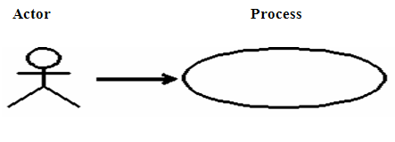
Use Case
A use case defines a goal-oriented set of interactions between external actors and the system under consideration.
use cases capture who (actor) does what (interaction) with the system, for what purpose (goal), without dealing with the system internals
A use case is a set of activities that produce some output result. It describes how the system reacts to an event that triggers the system
Notes:
Notes:
A use case defines a goal-oriented set of interactions between external actors and the system under consideration.
Use cases address all functional requirements and it is written from a user perspective. It is the story of interactions between actors and the system. A use case is initiated by a user with a particular goal in mind, and completes successfully when that goal is satisfied. It describes the sequence of interactions between actors and the system necessary to deliver the service that satisfies the goal. It also includes possible variants of this sequence. For example, alternative sequences that may also satisfy the goal as well as sequences that may lead to failure to complete the service because of exceptional behavior, error handling, and so on. The system is treated as a "black box", and the interactions with system, including system responses, are perceived from outside the system.
Thus, use cases capture who (actor) does what (interaction) with the system, for what purpose (goal), without dealing with the system internals. A complete set of use cases specifies all the different ways to use the system, therefore, defining all behavior required of the system and bounding the scope of the system.
Use cases are a text-based method of describing and documenting complex processes. A use case is a set of activities that produce some output result. It describes how the system reacts to an event that triggers the system. Use cases add detail to the requirements outlined in the requirement definition.

Slide 15
Use Case
It is the story of interactions between actors and the system
A use case is initiated by a user with a particular goal in mind, and completes successfully when that goal is satisfied
It describes the sequence of interactions between actors and the system necessary to deliver the service that satisfies the goal.
It also includes possible variants of this sequence

Slide 16
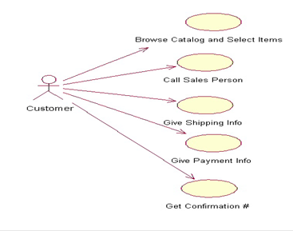
Example of a Use Case

Slide 17
Components Of Use Cases
The components of Use Cases can be categorized as follows:
Primary Flow
Alternate flows
Exception Flows
Triggers (an event or action that initiates the use case)
Pre Conditions (These are conditions that need to be set for performing the activity to achieve the goal)
Post Conditions (These are the conditions that need to be verified by the tester after the activity is performed)
Notes:
Notes:
Use Case includes the following variants of sequence:
Basic Flow sequence to satisfy the goal
Alternative sequences that may also satisfy the goal
Sequences that may lead to failure in completing the service because of exceptional behavior, error handling, and so on
The components of Use Cases can be categorized as follows:
Primary Flow
Alternate flows
Exception Flows
Triggers (an event or action that initiates the use case)
Pre Conditions (These are conditions that need to be set for performing the activity to achieve the goal)
Post Conditions (These are the conditions that need to be verified by the tester after the activity is performed)

Slide 18
Example Of Use Case
Example Of Use Case for booking an ola cab:
Basic Flow:
PreCondition 1: Customer should have ola app with internet working
PreCondition 2: App displays available cab’s near by
Activity: Customer Books the cab
PostCondition: cab will be get booked & Customer gets confirmation in his mobile.
Alternate Flow:
PreCondition 1: Customer should have ola app with internet working
PreCondition 2: App displays available cab’s near by
Activity: Customer Books the mini cab
Activity: App checks for the cab & display no cab’s available in mini
Activity: Customer Books the micro cab
PostCondition: cab will be get booked & Customer gets confirmation in his mobile.

Slide 19
Example Of Use Case
Exceptional Flow:
PreCondition 1: Customer should have ola app with internet working
PreCondition 2: App displays available cab’s near by
Activity: Customer Books the mini cab
Activity: App checks for the cab & display no cab’s available right now please book after sometime
PostCondition: The customer books cab from other app

Slide 20
UseCase Modeling: Creating Test Scenario
Test Scenarios describe what an actor can do by using the basic flow and alternate flows from start to finish, through the use case
In other words, the scenario is an instance of a use case and represents a single path through the use case.
When Use Case modeling is used for Test Scenario design, the following scenarios should be concentrated:
Primary flow or the happy flow
Alternate Conditions
Exception conditions
The following tips will prove handy while creating Test Scenarios:
All scenarios will start in the main flow
It is useful to draw a picture
Use a scenario matrix to keep track of them

Slide 21
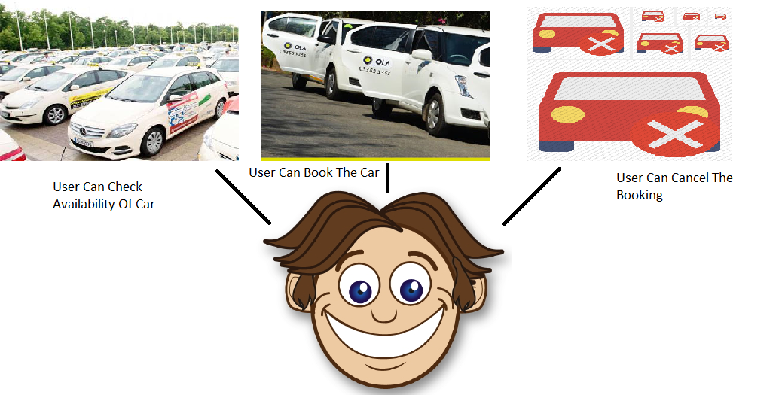
UseCase Modeling: Creating Test Scenario
Consider an ola app with following requirement:

Slide 22
Scenario Id | Scenario Description
SCN-001 | To Verify whether application displays cabs available nearby
SCN-002 | To Verify whether application allows the user to book the book of his need
SCN-003 | To verify whether application allows the user to cancel booked cab
SCN-004 | To Verify whether application allows the user to view his all booking
SCN-005 | To verify whether application denies the user to book the cab which are not available

Slide 23
Benefits Of Using Use Case Modeling
Allows testers to write test cases before any code is written
Provides a clear testing methodology
Gives testers a head start in understanding what the application is supposed to do
Helps you know when you are done
Helps to create Test Scenarios with the help of Use Cases

Slide 24
Ace Methodology
ACE Methodology helps to build re-usable Test Scenarios using the Functional Decomposition Model.
ACE (Activity-Component-Element) methodology is a functional decomposition technique which breaks business processes into activities, components, and elements to bring out the underlying functional complexity
Notes:
Notes:
ACE Methodology helps to build re-usable Test Scenarios using the Functional Decomposition Model. ACE (Activity-Component-Element) methodology is a functional decomposition technique which breaks business processes into activities, components, and elements to bring out the underlying functional complexity. This is done by translating business scenarios to reusable set of test scenarios, ensuring coverage and traceability. ACE can also be used as a training tool to enhance the Domain specific knowledge of the testing team.
ACE helps in the following:
Understand the Business Area
Capture the functional use
Business process at multiple levels
Componentization
Drill down to the Business Elements
Understand its implication
Traceability
Hand-shake

Slide 25
Building Test Scenario using the ACE Methodology:
The requirements are analyzed and business areas are identified
On analyzing the requirement, the scope and the expectation of testing to be derived is identified
Workflow is derived from the analysis of the business process at multiple levels
By analyzing the workflow the re-usable Test Scenario and its description is arrived
Using the re-usable test scenario, basic, alternate, and exceptional flows can be generated which are specific to an application

Slide 26
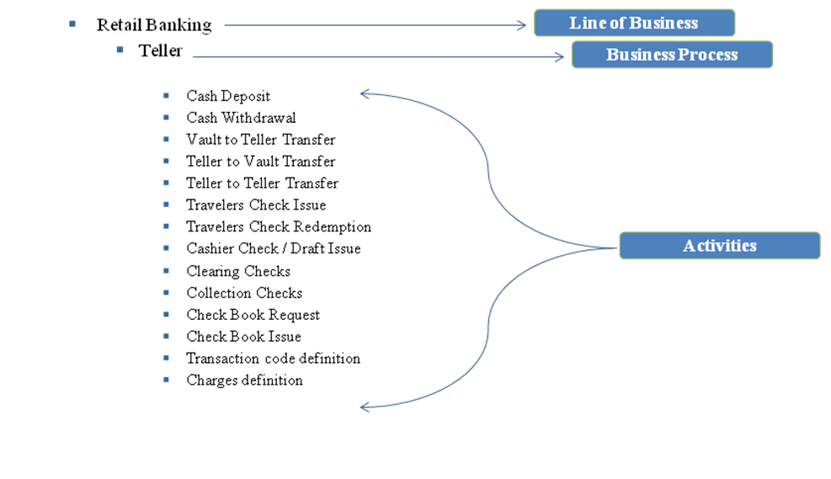
ACE Example
In a banking environment, ‘Retail Banking’ is a Line of Business. In ‘Retail Banking’ the Teller is a business process and various activities that are performed by a Teller are as follows:

Slide 27
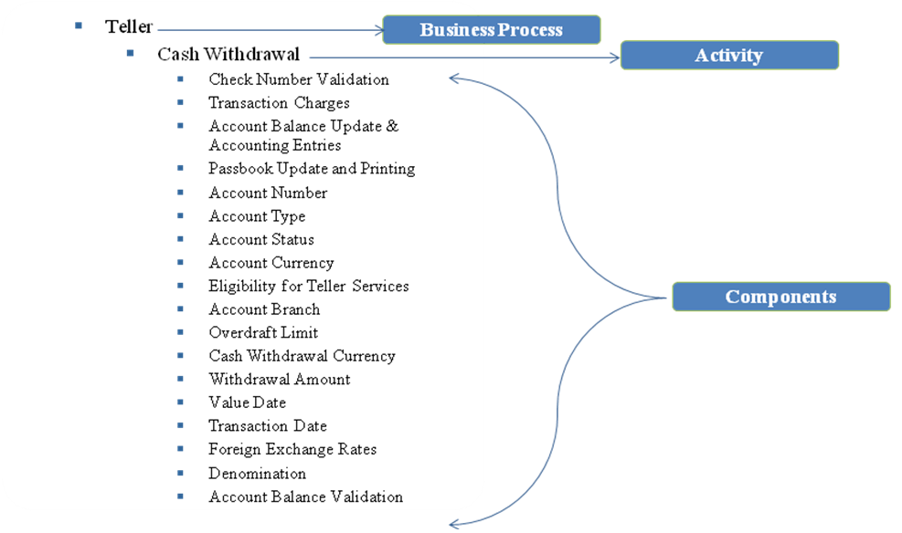
ACE Example Continued
In the Teller System for the Activity ‘Cash Withdrawal’, the different components which could be part of this activity are listed as below:

Slide 28
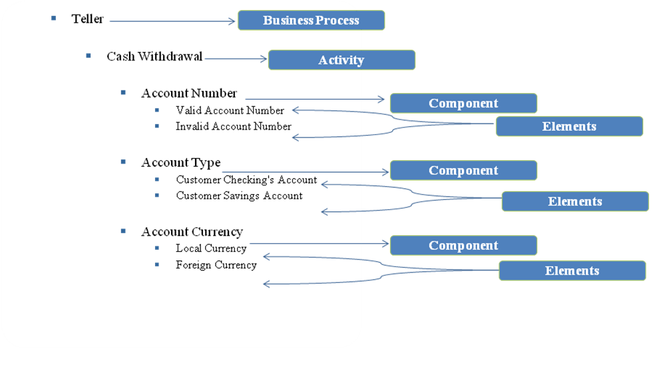
ACE Example Continued
Similarly, we can list the components for all the activities that are identified for the Teller System. Some of the following components can be derived from the Teller System:

Slide 29
Benefits of ACE Methodology:
Reduced Knowledge Acquisition time
Knowledge Transition to address only the delta that is Application/Geography specific
Advanced test analysis like the critical functionalities can be tracked before hand
Advanced test analysis like the critical functionalities can be tracked before hand
Advanced test analysis like the critical functionalities can be tracked before hand
Advanced test analysis like the critical functionalities can be tracked before hand
Advanced test analysis like the critical functionalities can be tracked before hand
Advanced test analysis like the critical functionalities can be tracked before hand
Advanced test analysis like the critical functionalities can be tracked before hand
Notes:
Notes:
Benefits of ACE Methodology:
Reduced Knowledge Acquisition time
ACE Methodology helps us to understand the business processes better and the workflows created for ACE can be used by newly joined team members for understanding the application which would help to reduce the Knowledge Acquisition time
Knowledge Transition to address only the delta that is Application/Geography specific
Business processes from a particular Line of Business will be the same, so only the Application /Geography specific KT is needed if we are implementing the ACE for a different project
Advanced test analysis like the critical functionalities can be tracked before hand
ACE way of doing analysis helps to identify the critical functionalities during the Test Scenario phase itself
Improved domain coverage paving way to addressing the testability at a granular level
ACE helps to improve the Domain Coverage as well the Test Coverage. Test Scenarios at a very granular level for the Business Processes can be obtained from ACE Methodology
Enhanced test design with Test scenarios and Test conditions clearly defined
Identifying Activity, Component, and Element using ACE will help to improve the Test Design as Test Scenarios and Test Conditions can be clearly defined using ACE Methodology
Easier traceability to the Business Requirement/Functional Specification document
In ACE Methodology, the Test Scenarios are identified from the Business Processes, so requirement traceability can be achieved easily
Translates to sanity check on critical functionalities
Test Scenarios created from ACE Methodology can be used for Testing the critical functionalities during the Sanity Testing phase
Such scenario libraries leads to very high re-usability
Test Scenarios created from ACE Methodology are re-usable for any future projects of the same nature
A robust regression pack from a functional perspective
Test Scenarios created from ACE Methodology helps us to build robust regression Test Suite

Slide 30
Test Development Process

Slide 31
Test Development Process
Test Development process involves the following activities:
Identify Test Cases for the Test Scenarios (include all Scenario Types: - Basic, Alternate and Exception)
Identify inputs, execution pre-conditions, and expected outcomes
Use Test Case Syntax and build the Test Steps
Update Traceability Matrix with the Test Case details and perform Traceability Matrix Review
Test data preparation to support the test conditions and test cases
Test Runs

Slide 32
Test Case
A set of inputs, execution preconditions, and expected outcomes developed for a particular objective, such as to exercise a particular program path or to verify compliance with a specific requirement.
A test case has the following features:
A high probability to find an error
Helps to discover information
Must be written for the invalid and the unexpected, as well as for valid and expected conditions
Should not be redundant and neither too simple nor too complex (more than one expected result)

Slide 33
Test Case Includes:
Test case includes the following elements:
Purpose of the test or description of what requirement is being tested
Method of how it will be tested
Setup to test: version of application under test, hardware, software, operating system, data files, security access, time of day, logical or physical date, prerequisites such as other tests, and any other setup information pertinent to the requirements being tested
Actions and expected results, or inputs and outputs
Any proofs or attachments (optional).

Slide 34
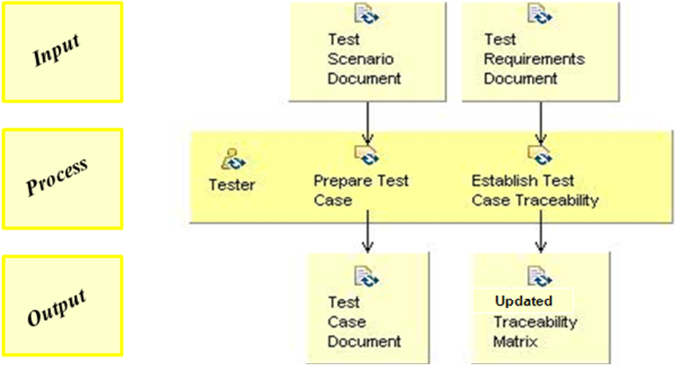
Entry Criteria to Test Case Development Process
Following are the entry Criteria to Test Case design process: Freezed (without any further changes) Business processes/Requirement Documentation
Approved Test Plan
Approved Test Scenarios
Approved Standards for Test case documentation
Approved Standards for Test case naming convention
Test Data Source

Slide 35
Task During Test Case Development Process
Creation of Test Cases
Creation Of Test Data
Updating RTM

Slide 36
Validation During Test Case Development Process
Reviewing Test Cases Prepared
Reviewing Test Data Prepared
Reviewing Updated RTM

Slide 37
Exit Criteria to Test Case Development Process
Approved Test Cases
Updated RTM

Slide 38
Test Scenario to Test Case
From the scenarios, the basic and alternate flows could be considered to write the test cases. Thus, multiple test cases could be generated for a single scenario. Both positive and negative test cases can be derived for a single scenario
Identify test conditions as follows:
For each flow, identify the input variables for each step. Input variables are the parameters that the user provides as input.
Find out the significantly different options for each of the input variables.
Identify the various possible combinations of the above options.
Combine test conditions along with the identified scenarios to be tested into test cases.
Decide on whether to combine or split the test cases for each of the different flows (basic, alternate).

Slide 39
Test Case Components
Following are the components of Test Case:
Test Case ID
Test Case
Pre-requisite
Steps To Execute the test case
Test Data
Expected Result
Actual Result
Pass/Fail
Defect ID
Remarks
Notes:
Notes:
Test Case ID: It is a unique ID to identify a test case. This can be as per the agreed naming standards from the client.
Test Case: This section describes the test case objective/ description of the what the test case is intended to test
Pre-Requisites: This section details the actions that are required beforehand that is, a necessary action that is to be completed before start of the Test case
Steps to Execute the Test case: This section describes the steps to execute the test. It includes the user actions to be performed, navigation flows to other screens, providing appropriate inputs, verification point, and so on.
Test Data: Test Data is an optional column. It can be given as a part of steps to execute or at times given as a separate column in a test case.
Expected Results: The outcome that is expected to happen when the “Steps to Execute” are performed is detailed in this section.
Actual Results: The outcome that happened as a result of executing the test steps will be entered in this section during the test execution phase.
PASS/FAIL: The status of the test step is decided based on the expected result and actual result. When both results are the same the step is ‘PASS’ and when there is a deviation of the actual from the expected then the step is Failed
Defect ID: This section includes the Defect ID (unique number) that is raised against the failed test step for this test case. Same test case can be mapped to more defects and same defect ID can be mapped to more test cases.
Remarks or comments about the test case or test execution or any general remarks will be listed against the test case if any.

Slide 40
Guidelines – How To Prepare a Test Case?
Develop Test cases to verify that the specific requirements or design have been satisfied.
The Test case objective should be brief and clear.
A Test Case Identifier like a Test Case ID or a Test Case Name must be provided.
All steps/actions must be written in imperative tense
Mention pre-condition in test case, wherever necessary.
Test Case Description must be provided for every test case.
Test Case Description must begin with “To check….” or “To validate….” or “To verify…”
Describe the steps to execute the test and at each step describe the expected results.
There must be no ambiguity in the step that is to be executed.
Expected result must contain words like “should” rather than “is/may/shall/might”.

Slide 41
Guidelines – How To Prepare a Test Case?
When data is saved in a screen, it is recommended to close and re-open the screen in order to ensure that the data is saved in the database.
If user has to provide input to the application, mention specific test data. Test data can either be provided in the step itself or in a separate column (if provided).
It is advisable to build a test suite in such a way that it will bring back the test environment to its initial state at the end of testing. By writing such self-cleaning test cases, the need for a database refresh for every round of testing can be avoided.
Each functionalities needs to be tested with at least two test cases: Positive and Negative inputs for the Basic scenario.
In case of UAT testing, ensure that the test cases have been developed to validate business logic and appropriate profiles been identified for the business flows.
Negative test case step must be written first followed by the positive test step.

Slide 42
Guidelines – How To Prepare a Test Case?
Develop Test cases to include the boundary values, special values, and invalid values.
Generate Test cases based on the type and scope of testing.
Develop Test cases to validate all functionality specified in the requirements.
Generate Test cases to test the software performance.
Each Test case has to be numbered and named as per the standards.
Provide Traceability to a requirement for all the Test cases.
Do not use any acronyms or symbols.
Develop Test cases with the following details wherever applicable:
Test case description

Slide 43
Guidelines – How To Prepare a Test Case?
Author’s name
Date created
Setup Procedure
Pre-requisites
Do not include any redundant Verification Points in the test case.
Any reference to a button should be made using square brackets and the button label must be written in CAPS.
Reference to any object name such as a window or a label must be written within double quotes and the object name must be written in title case.
Reference to any input data being provided must be given within single quotes.
Do not use colored font to write any steps or verification points.

Slide 44
Guidelines – How To Prepare a Test Case?
A good Test Case should be:
Accurate: The test case should test what the test case description says.
Economical: It should have only steps needed for its purpose.
Repeatable: It should produce the same result no matter who runs it.
Appropriate: It should be for immediate and future test.
Traceable: It should be traceable to the requirements.
Self-Cleaning: It should return the test environment to clean state.

Slide 45
Some of the common test case mistakes are as follows:
Making Test cases too long
Incomplete, incorrect, or incoherent setup
Leaving out a step
Naming fields that changed or no longer exist
Unclear whether tester or system does action
Unclear what is a pass or fail result
Failure to clean up

Slide 46
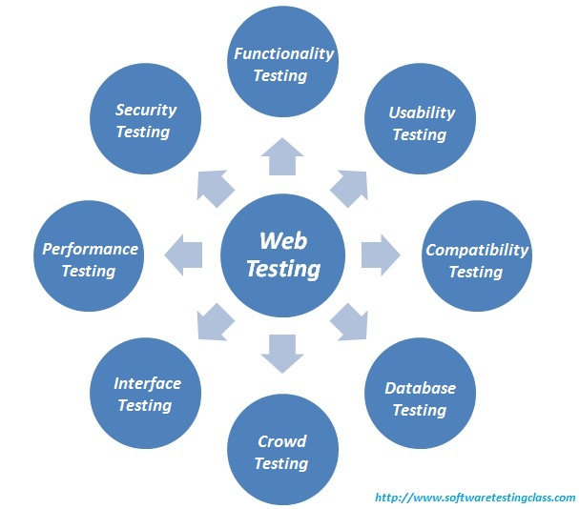
Web Testing
Web Testing in simple terms is checking your web application for potential bugs before its made live or before code is moved into the production environment.
During this stage issues such as that of web application security, the functioning of the site, its access to handicapped as well as regular users and its ability to handle traffic is checked.
The testing is totally based on your web testing requirements but following is the standard checklist of web testing:

Slide 47
Requirements Traceability Matrix
What is a Requirements traceability matrix (RTM?
Requirements traceability matrix (RTM) is a document that traces and maps user requirements [Requirement IDs from requirement specification document] with the test case IDs.
Purpose is to make sure that all the requirements are covered in the test cases identified, so that no functionality can be missed while testing.
How does it help?
Gives confidence to client that the software is being developed as per the requirements.
Required to make sure that all requirements are included in the identified `test cases.
RTM makes it easy to identify the missing functionalities
Through RTM we can get the idea of “Extra” functionality that may have been implemented but not specified in the design specification. Hence gives the idea of wastage of manpower, time and effort.

Slide 48
Test data is the data which is used
By automation tools
For functionality tests
Used in Tests in software testing
To validate the results

